Slide 1
Lecture 2: BA at the Strategic Level
Prof. Mike Boyle
Department of Operations and Information Systems
University of Utah

Slide 2
BA at the Strategic Level
“Analytics themselves do not constitute a strategy, but using them to constitute a distinctive business capability certainly constitutes a strategy.” *
Source: Davenport et al, “Competing on Analytics”, Harvard Business Press, (2007)

Slide 3
Data-driven Decision-making at Modcloth
video: first 15 minutes

Slide 4
BA at the Strategic Level: Two Main Related Questions
How can the BA function influence the strategy process?
How does the strategy influence the BA function?

Slide 5
What is a Strategy?
Strategy
Definition: “…description of the overall way a business is run.”
Covers one (1) to two (2) years
Updated annually (typically)
Relative changes vs. wholesale changes
Purpose: allocate the organization’s business area, resources, and activities effectively within the operating marketplace

Slide 6
What is a Strategy? (cont’d)
Strategy
Concept: handle short term issues while creating competitive advantages in the longer term
Implementation
A set of specific, measurable, reasonable targets to be achieved by individual parts of the organization
Related assumptions
Information is used strategically to coordinate processes in parallel
Information is used tactically to execute on and improve processes in serial

Slide 7
Setting Key Performance Indicators (KPIs)
Purpose: KPIs measuring points linking activities to objectives
Guidance:
Have only a few
Make sure each one is an effective link from the activities of groups and individuals to a given objective (either departmental or organizational)

Slide 8
Vision, Mission and Strategy
Vision: “…long term goals…”
Mission: “…brief outline of how to achieve long term goals…”
Strategy: (see previous slides for simple definition and other details)

Slide 9
BA and Strategy: Three Perspectives
Scenario Perspective
Strategic Position Perspective
External Perspective

Slide 10
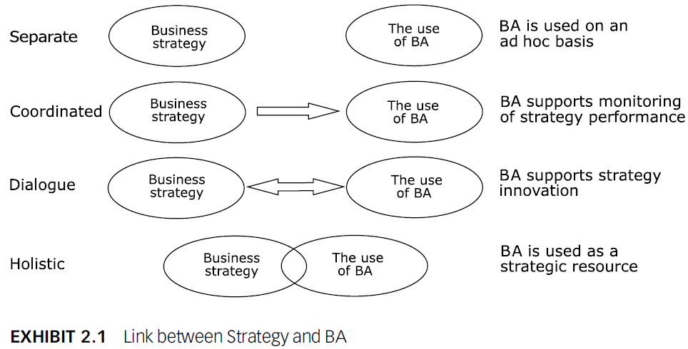
BA and Strategy: Scenario Perspective
Four common scenarios, increasing in degree of:
Integration between BA and Strategy
BA competency (i.e. technical and analysis)
Investment in BA (i.e. people, technologies, etc.)

Slide 11

Scenario 1: Separate
Common attributes:
Data is used to answer ad hoc questions (i.e. reactive vs. proactive)
No feedback loop from BA to Strategy process
Staff likely to have very general skills only somewhat related to analytics technologies and data science
Limited and/or siloed and/or low quality data

Slide 12

Scenario 2: Coordinated
Common attributes:
BA function is performing monitoring of individual functions’ achievement of targets set by the Strategy process
No feedback loop from BA to Strategy process
Relatively small investments made in technologies and staff responsible for the monitoring/reporting function
Through consistent use/visibility data quality, integration and breadth improves relative to Separate Scenario

Slide 13
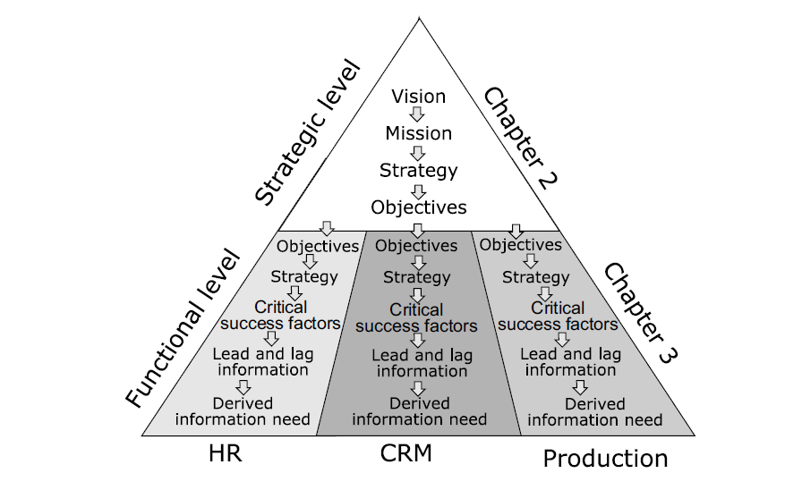
Scenario 2: Coordinated (cont’d)

Slide 14
SMART Targets
Targets should be:
Specific: increase 200% vs. increase “a lot”
Measurable: quantitative (even if it’s imperfect) vs. qualitative
Agreed upon: ownership and accountability are necessary for achievement
Realistic: if it is not realistic, it won’t likely be agreed upon
Time-bound: if a deadline is not set when to stop and reassess will be unknown

Slide 15

Scenario 3: Dialogue
Common attributes:
BA function is performing monitoring of processes and is providing analyses related to their performance
Analyses support both process improvements and strategic decision-making
Feedback loop established from BA to Strategy process
Relatively large investment made in analysis staff; Investments in technology likely related to analysis staff productivity
Through consistent use/visibility and dialogue around data, quality, integration and breadth improves relative to Coordinated Scenario

Slide 16
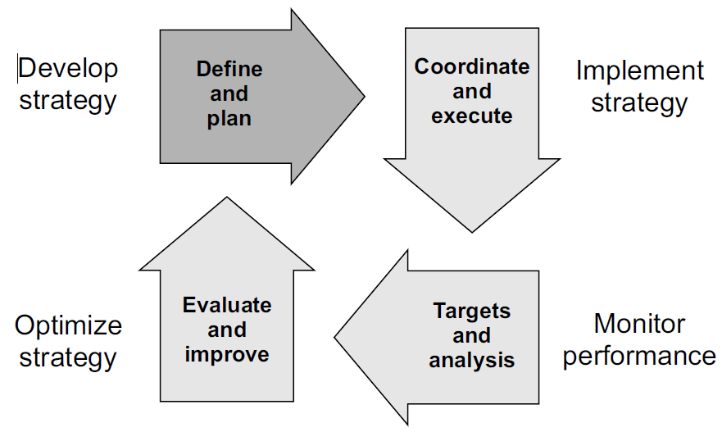
Scenario 3: Dialogue (cont’d)

Slide 17

Scenario 4: Holistic
Common attributes:
BA function is performing monitoring processes, providing analyses related to their performance and is represented at the executive level
Feedback loop established from BA to Strategy process
Relatively large investment made in BA staff (technology, analysis, leadership); Investments in BA technology are aligned with the Strategy
Through data being a priority at the highest level and consistent use/visibility and dialogue around data, quality, integration and breadth improves relative to Dialogue Scenario

Slide 18
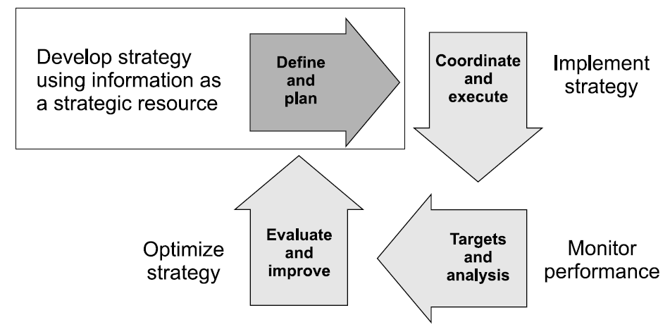
Scenario 4: Holistic (cont’d)

Slide 19
Discussion: Scenario Perspective
Does it make sense for all organizations to aim for the Holistic Scenario as soon as possible?
Answer: No. It depends on competitive landscape.

Slide 20
BA and Strategy: Three Perspectives
Scenario Perspective
Strategic Position Perspective
External Perspective

Slide 21
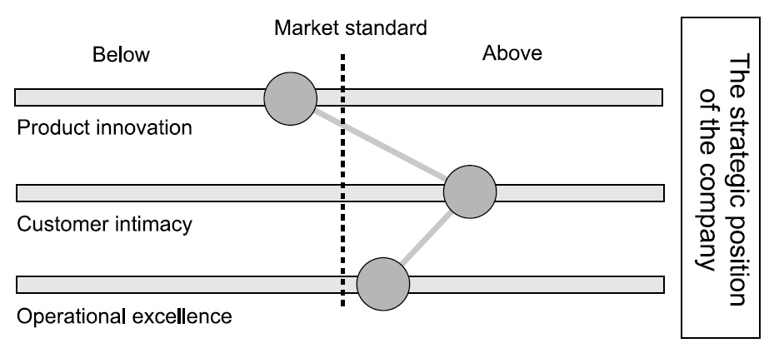
Strategic Position Perspective
Discussion: how would you describe the strategic position of Modcloth?

Slide 22
Strategic Position Perspective: Which Information to Deliver?
Understanding the strategic position of the organization provides direction as to which information should be delivered by the BA function
Dimensions:
Product Innovation
Customer Intimacy
Operational Efficiency
Article “Three Paths to Market Leadership” suggests being better than the competition on one of the dimensions and equal on the two others in order to lead in a market

Slide 23
Product Innovation
Organization provides “state of the art” products
E.g. IT-based solutions, technical apparel
BA projects are oriented around the product and related competitive marketplace

Slide 24
Customer Intimacy
Establishing and maintaining increasingly meaningful customer relationships
E.g. Banks, insurance companies, telecoms
E.g. Companies that have high degrees of penetration in mature markets focus on:
Retaining existing customers
Acquiring new customers from competitors
BA projects are oriented around understanding customers
Discussion: What are some of the differences in analyzing products as compared to customers?

Slide 25
Operational Efficiency
Efficient with the production and delivery of services and products by optimizing internal processes
Typically capital-heavy businesses
E.g. Cement factory
Can’t be a product innovator; customer intimacy is less relevant compared to price and availability
Therefore, compete on price and availability (i.e. an Operational Efficiency approach)
Alternatively economies of scale businesses (i.e. the more that is produced, the cheaper it gets)
E.g. Airlines, hotels, logistics companies, manufacturers

Slide 26
BA and Strategy: Three Perspectives
Scenario Perspective
Strategic Position Perspective
External Perspective

Slide 27
External Perspective
Competitors
Marketplace: current and future
Lead or Follow?

Slide 28
External Perspective: Competitors
Who are your competitors?
What are their market positions?
What are their strategies?

Slide 29
External Perspective: Marketplace – Current and Future
Today and in the future:
What is your market?
Who are your customers?
Who are your competitors?
How are your customers changing? Where are they heading?
Is your market growing/shrinking?
How would you expand your market?

Slide 30
External Perspective: Lead or Follow?
Is your strategy to lead or to follow?
Most people default to “lead” without considering the associated risks
Refine to “extreme lead”, “lead”, “follow”, “extreme follow”

Slide 31
Periodic Review of Analytical Environment Framework
Constant review to create new insights
Review strategy and business models
Review analytical targets
Review competitors
Review customers and partners
Review data and technology
Review and manage models
Concept: Perform regular reviews of the components of your BAM
Davenport et al presents a good framework for this purpose
Source: Davenport et al, “Analytics at Work” Harvard Business Press, 2010, pp. 150 - 160

Slide 32
Appendix

